Slide 1


Delivering safe, effective, person-centred care and improving the experience for patients with dementia in the acute ward setting
Maria Loughran, Orla Mathews, Jordan Black
2015 – present day
‘‘A friend is someone who knows the song in your heart and can sing it back to you, even when you have forgotten the words’’

Slide 2
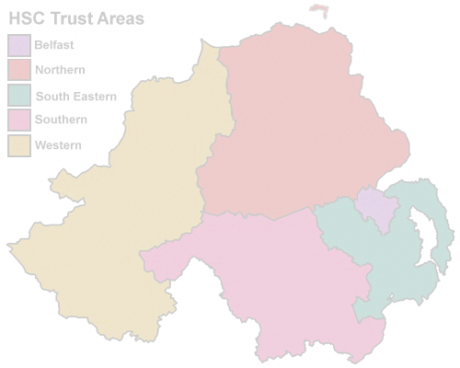
The Northern HSC Trust
1 of 5 Health and Social Care Trusts in N.I.
471,000 population
Largest geographical trust in Northern Ireland
2,494 registered nursing beds in Private Nursing Homes (PNH)

Slide 3

CONTEXT
An aging population – changing demography (by 2020 the number of people over 75 years will increase by 40% and over 85 years increase by 58%)
Increased dependency, complex client-needs, multiple comorbidities
Transforming Your Care (2011) Right Care, Right Place, Right Time (https://www.health-ni.gov.uk/topics/health-policy/transforming-your-care)
RCN ‘Care in Crisis’ Survey 2015 (https://www.rcn.org.uk/-/media/royal-college-of-nursing/documents/publications/2015/october/005348.pdf)

Slide 4


Together we achieve more!
Project Partners!
.
.
.

Slide 5

Background:
Dementia is a major public health challenge for the 21st century
There are approximately 23,000 people in Northern Ireland with a diagnosis of a dementia disease
Approximately 42% of medical admissions have a secondary diagnosis of dementia (Timmons et al., 2015; Travers et al., 2013)
Admission to hospital can be extremely distressing for people living with dementia and their families - poorer outcomes such as cognitive/functional decline
Acute care environments are often not conducive to meeting the needs of patients with dementia
Northern Ireland Audit of Dementia Care in Acute Hospitals 2015
NICE, 2006; Dewing, 2009; McCormack and McCance, 2017
Let’s talk about dementia…

Slide 6
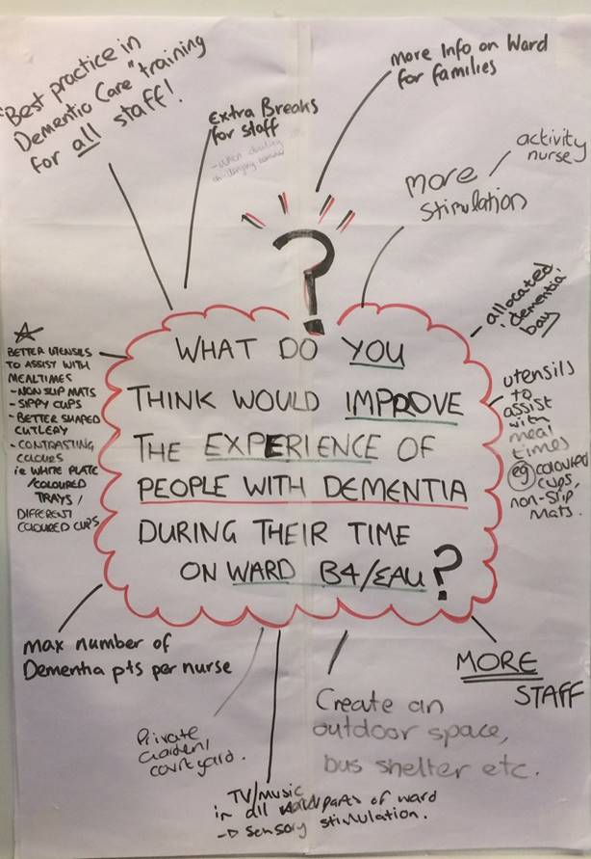
The start of our journey:
We wanted to improve experience for patients with a dementia and enhance the acute care environment
Successful FoNS Application 2015 for the Patients First Programme
Director of Nursing and senior nursing support
Ward context - Elderly acute ward (B4), busy acute 22 bedded unit at Antrim Hospital, Northern Ireland
Starting point involved collating ideas from entire team - flip chart, markers and post-its
Clarifying of values and beliefs - shared vision and purpose - more flip chart and coffee and biscuits!

Slide 7
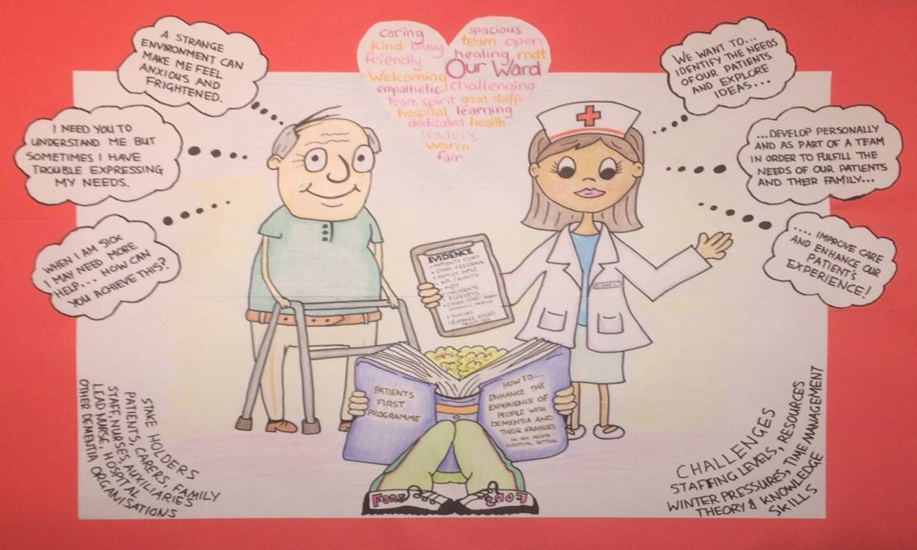
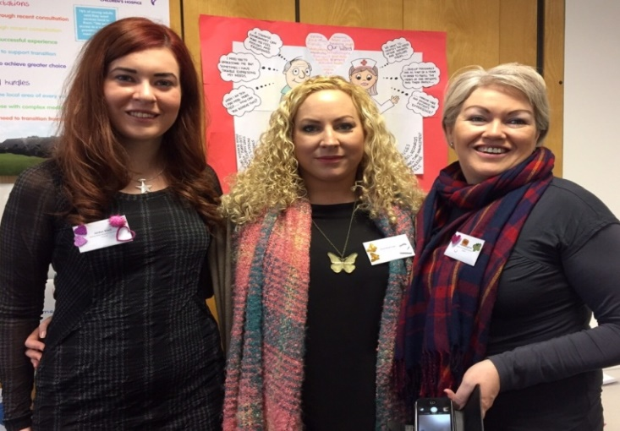
FoNS Support:
Through FoNS, vital resources and funding were secured which enabled project development
We learnt the fundamentals of active learning in practice development
Focused on practice development methodology … periodic evaluation … reflection and creativity

Slide 8
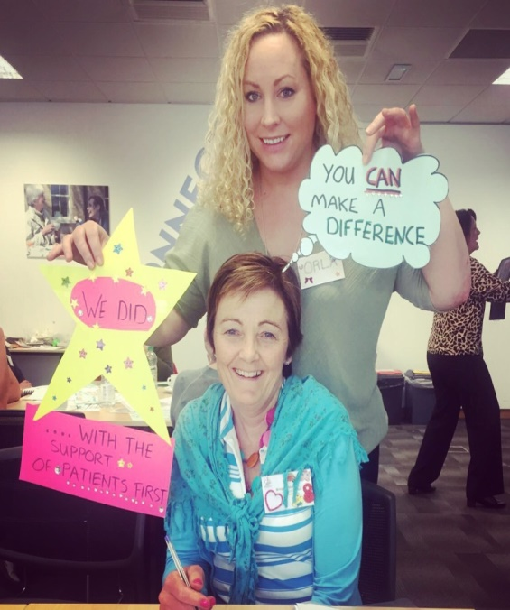
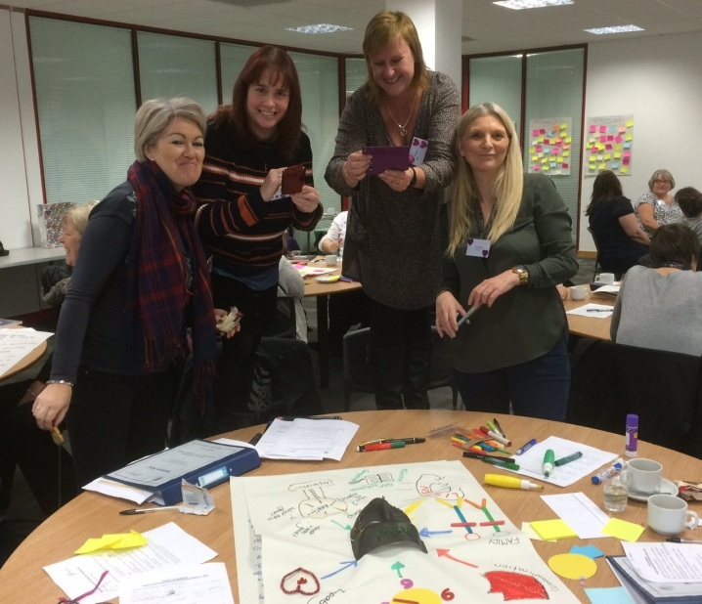
FoNS Support:
FoNS facilitated workshops in London ensured protected time and space to explore and develop person-centred practice development ideas
Maintained momentum and focus and created renewed energy and ideas
Shared learning and support from UK wide colleagues from all disciplines and areas of practice with the same challenges
Helped us to develop action plans
Truly invaluable
Jo visited us right here in Northern Ireland and in our own Trust offering high challenge, high support, expert facilitation to enable us to see away forward when the going got tough!

Slide 9
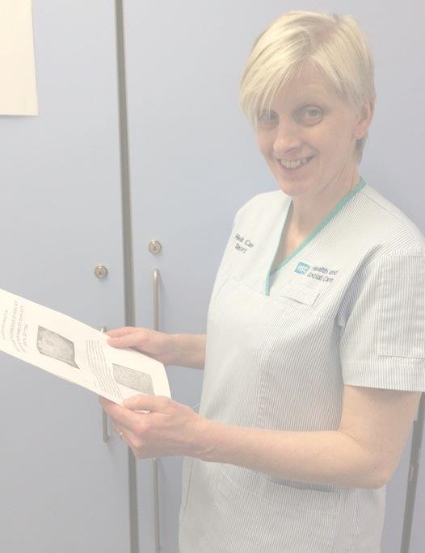
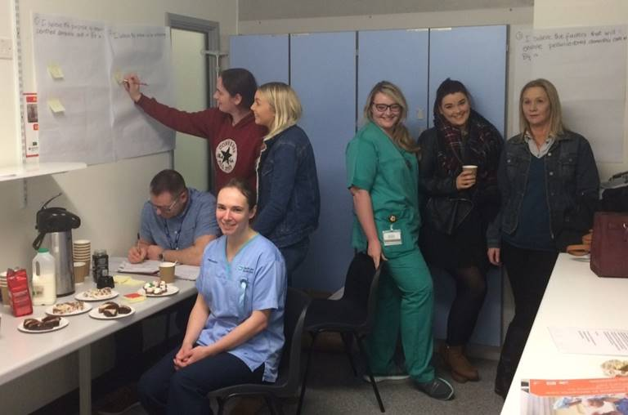
TEAM VISION:
In order to develop a shared vision for person-centred care, we had to ensure our staff were being listened to and empowered and engaging with the project in order to facilitate transformations in the workplace
We completed a values and beliefs clarifications exercise ...

Slide 10
Values clarification - enablers identified
Values clarification - inhibiting factors identified
We discussed the shared themes and ideas that staff had: - our action plan…
Values clarification - staff said
The purpose of person-centred dementia care is:
To maximise patient comfort
For patients to feel safe and cared for
For families to feel their loved one is being given good quality care
To set a high quality nursing standard
To make sure the needs of someone with dementia are considered and cared for
A quiet space for patients if the busy ward setting is causing distress
Environmental changes - signs, clocks, music, information resources for families, flexible visiting
More training -dementia awareness
Activities - reminisce folders
Equipment - coloured cutlery, dinnerware and drinking cups
An outdoor space
Communication and handover
Knowing the patient well
Support staff
Involving patients and their families
Good documentation and care planning
Multi-professional team working
Not always knowing the person well enough - their story
Not always involving their families
Handover and communication between nursing and nursing support staff
Ward environment
Training

Slide 11
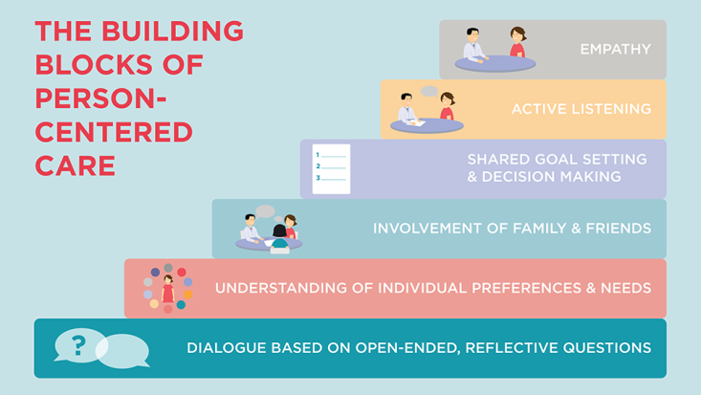
Established a MDT Steering Group:
Jo (FoNS Practice Development Facilitator) helped to facilitate this group
Using a values clarification exercise, we explored with the group
‘what does person-centred care look like?’
‘One small change can have an enormous impact’
Some staff had never, in all their years working in healthcare, been asked about person-centred care, what
it means to them and how they contribute to it!!
Members talked about how their contribution felt valued
Members reflected on the value of ALL our roles in safe, effective person-centred care
Steering group met again few months
later

Slide 12
Outcomes
Environmental enhancements
Improved signage
Introduced coloured crockery and cups
Enhanced collaboration between catering and nursing staff aimed at improving patients nutritional experience
Increased training to all staff groups and hospital chaplaincy service
Increased recognition in the trust of the importance of improving experience for patients with a dementia

Slide 13
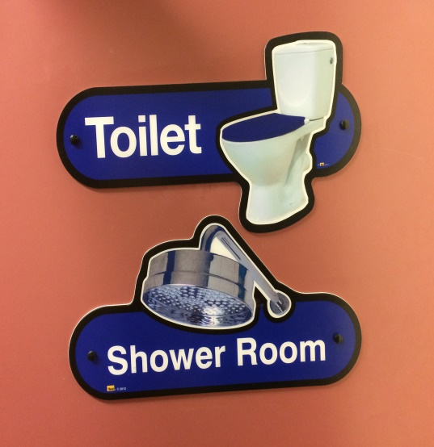
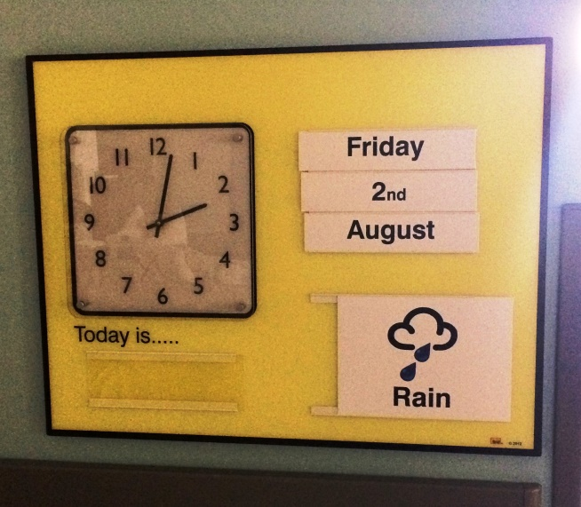
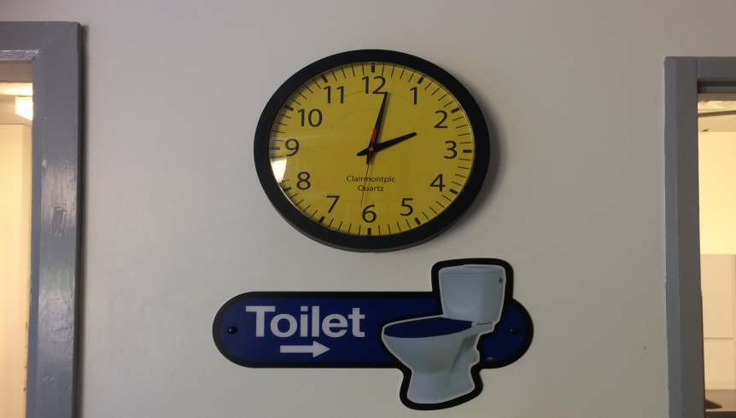
Next steps – quick wins
Quick wins like environmental changes (such as clear signage) and dementia friendly crockery kept up the team spirit and momentum of the project

Slide 14
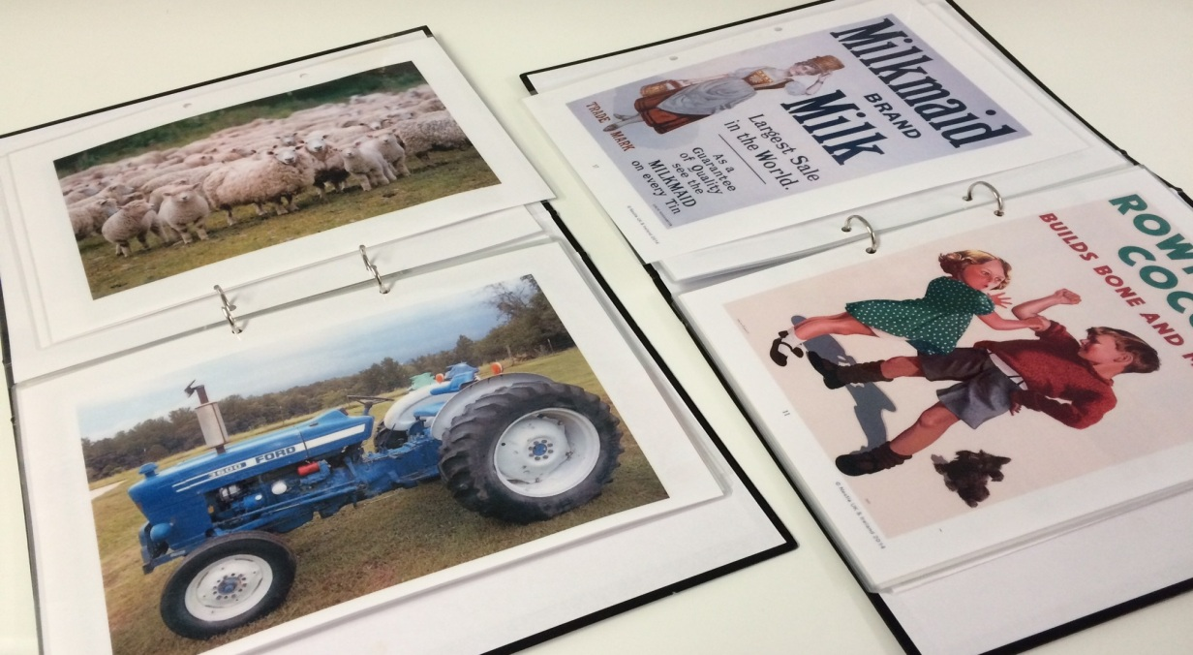
Next steps – quick wins
Reminisce folders were developed to use as a communication tool and to stimulate conversation for staff and for relatives when engaging with people living with dementia

Slide 15
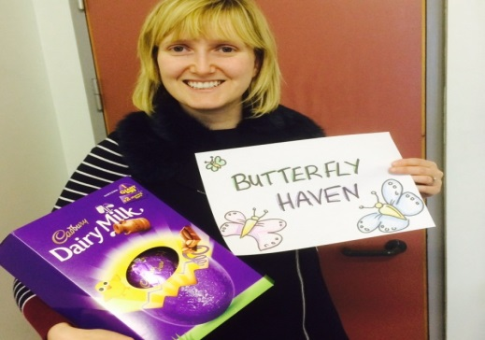
Next steps – small steps
Our shared vision - create a quiet space on ward for patients who may become distressed
Visible to the eye but not obvious!
After negotiation and patience we secured the room
We involved all the staff in naming the room … the winner received an Easter egg!
We used some of the FoNS bursary to refurbish the room
BUTTERFLY HAVEN WAS CREATED

Slide 16
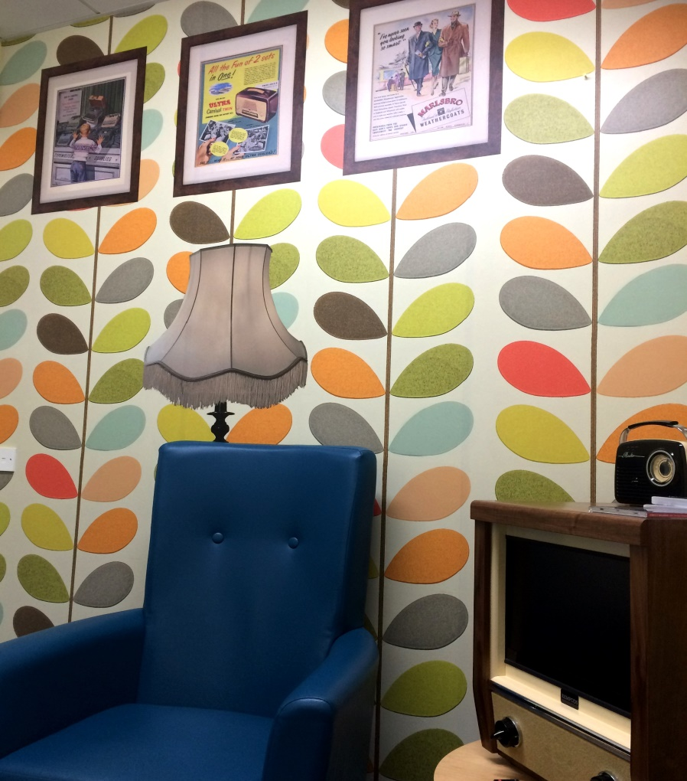
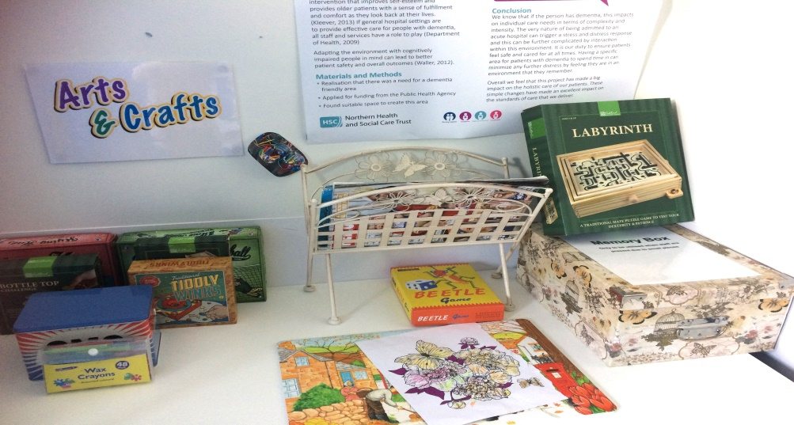

Next steps – small steps
Butterfly Haven

Slide 17
Next steps – big leaps!
Collated baseline data on falls and distressed behaviours to evidence outcomes
Secured funding from Public Health Agency (PHA) and Dementia Together NI
Collected patient, staff and family feedback and stories throughout duration of the project and beyond
We asked ourselves ‘did the Dementia Companion enhance the person-centred care and experience?’
This involved partnership and collaboration with many people… nursing, human resources, support services, multi disciplinary team, informatics
Develop the role of the Dementia Companion: a new, innovative role

Slide 18
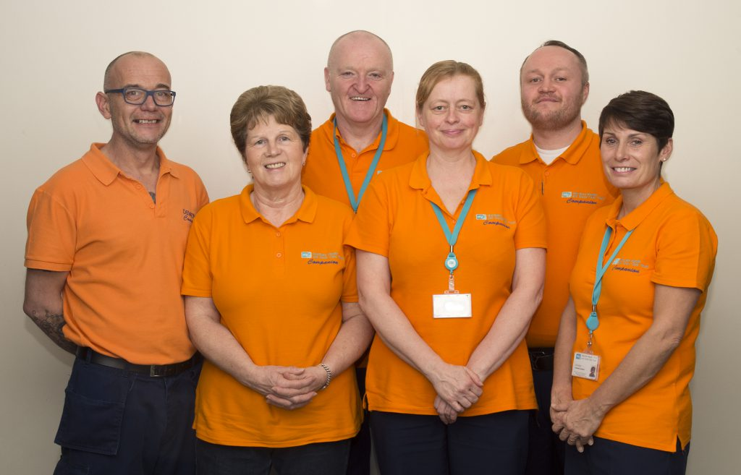
Role of the Dementia Companion
Recruited from domestic support staff and HCA at Band 2
Spend one to one time with all patients on the ward who have a dementia or confusion (nursed together)
Engage people with dementia helping them maintain their identity
Offer compassionate reassurance if they are distressed
Engage in activities using the reminiscence folders to facilitate stimulation
Safely allow patients who are wandering with or without purpose, minimising the risks of falls
Assist patients with their fluid and nutritional needs
Assist and support patients with activities of daily living - guided by nursing staff and following risk assessment
Maintain a tidy clutter free environment around bedside

Slide 19

Training and Induction for the Dementia Companion role
Ward Induction and full support of practice development facilitators, ward sisters, nursing team
Mandatory training: Basic Life Support (BLS), Infection Prevention and Control (IPC), Falls awareness, Safe patient moving and handling
Dementia awareness programme
Reflective learning sessions and peer support
Further training identified - dysphagia training and vulnerable adult/safeguard training
Collaboration with trust colleagues, Clinical Education Centre (CEC) and Alzheimer's Society
Dementia Learning and Development Framework (Department of Health, Social Services and Public Safety (DPSSPS), 2016. Belfast.

Slide 20

Evaluation of the role:
Qualitative:
Patient and family experiences and feedback
Staff experiences and feedback
Dementia Companion experiences and stories
Influential work of Kitwood (1997) and more recent research
Quantitative:
Examined the patient slips, trips and falls rate
Episodes of distressed behaviours or behaviours that challenge
Security staff costs and one to one requests

Slide 21

Quantitative Data
Reduced falls, although many variables contribute to falls and there are other regional initiatives as well
Reduced episodes of reported distressed behaviours
Reduced use of inappropriate security staff requests

Slide 22
Patient/family and staff feedback
Patients and relatives feedback: more settled and calm, don’t feel as isolated, someone to talk to during a long day, liked receiving the newspaper, looking at pictures (reminiscence folders), feel valued, increased confidence that loved one is safe from having a fall and being supported to eat and drink, dementia companion keeps us and the family updated
Nursing staff feedback: calming effect on ward and this extends into afternoon and evening, provides reassurance and stimulation, we know patients safe, reducing the risk of falls, patients can wander/walk safely, encourage food and fluid intake
Medical staff feedback: patients more calm and relaxed not as distressed, impact on RAID referral, remaining with patients who wander maintaining their safety, they show dignity, respect and compassion
Unexpected positive outcomes: Releasing nursing time to care, protection of vulnerable adults, involvement of the support services and catering department- all our roles are valued
The Dementia Companion role has also helped to reduce disorientation, behaviours that challenge, malnutrition, dehydration and functional decline

Slide 23
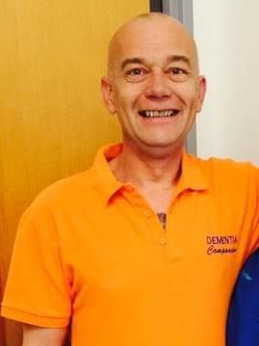
Dementia Companion Feedback
When you are asked to sit with a patient who has a dementia, they are unsettled, climbing out of bed, refusing all medication and nutrition, it is challenging. When I am with the patient and gain their trust, they will eat and drink and feel more calm and relaxed.
Patients may not remember my name but they remember my voice and the fact that I have spent time with them and made them feel safe.
I can honestly say this is the most rewarding job I have ever done in all my years as a care worker.’

Slide 24
Presented to all who wanted to hear!
Trust Board
Annual GAIN Quality Awards (runner-up)
RCNi Awards ‘Older People Category’ (shortlisted)
Completed an evaluation report
Regional Falls Group
HSJ Patient Safety Awards (shortlisted)
Secure funding to March 2018 and increased number of Dementia Companions
Dementia Companions – next chapter
Celebrating the achievements of the role of the Dementia Companions

Slide 25
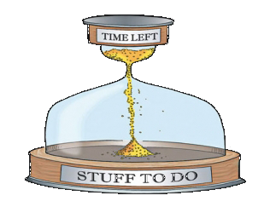
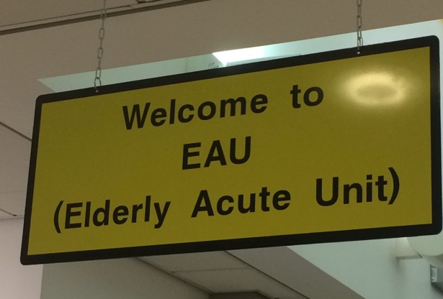

We did have challenges:
Securing funding
Lack of time
Busy day-to-day jobs
Operational ward changes
Competing priorities … the usual!
Moving ward areas - building works
Support from FoNS remained crucial
‘The messy world of practice development!’
Then you get a break!

Slide 26
Education
Facilitation
Values clarification
Collaboration
Multi-disciplinary
Team
Claims, concerns and issues
How did we make it real?
Steering group
Evaluation
Political influencing
Measurable outcomes
Innovation – Dementia Companions
Regional profiling
Celebrating success

Slide 27

What we have achieved
What started in one ward has had an impact across the whole organisation
We have embedded the Dementia Companion role across many clinical areas and secured recurrent funding for the introduction of the companions regionally across all 5 trusts
Ensured environmental enhancements in all our acute care medical wards
Increased awareness and understanding of dementia and how we need to adapt our behaviours
Orla Mathews recognised by RCN NI Nurse Manager of the Year 2017.
We commenced an art project in 2018, working with artist to support patients with a dementia to express through the medium of art

Slide 28




Acknowledgements
Thank you to the Foundation of Nursing Studies and Burdett Trust for all their support and guidance
We thank Jo Odell for her support, guidance and expert facilitation
We thank the NHSCT and all our colleagues particularly previous Executive Director of Nursing, Mrs Olive MacLeod and current Executive Director of Nursing, Mrs Eileen McEneaney, Assistant Director, Elizabeth Graham and Practice Development Nurse Facilitator, Martina Monaghan for their support and commitment to improving the experience for patients with a dementia coming into acute care wards
We thank Alzheimer's Society for their support of this project and all we are trying to achieve
We thank the Public Health Agency NI (PHA) and Dementia Together NI for their support in so many ways including financial
Patients and families who willingly shared their stories and feedback

Slide 29

Making a difference through Practice Development
One small change can have an enormous impact!

Slide 30
Contact Details
Maria Loughran; Lead Nurse Nursing Innovation and Practice Development Team NHSCT. Email: maria.loughran@northerntrust.hscni.net
Orla Mathews; Dementia Service Improvement Lead NHSCT. Email:
orla.mathews@northerntrust.hscni.net

Slide 31
References:
Department of Health, Social Services and Public Safety (2016) The Dementia Learning and Development Framework. Belfast. Northern Ireland.
Department of Health, Social Services and Public Safety (2011) Improving Dementia Services in Northern Ireland: A Regional Strategy. Belfast. Northern Ireland.
Department of Health, Social Services and Public Safety (2011) Transforming Your Care - A Review of Health and Social Care in NI. Belfast. Northern Ireland.
Dewing, J. (2009) Caring for people with dementia: noise and light. Nursing Older People. 21, (5), 34-38.
McCormack, B. and McCance, T.V. (2017) Person-centred Practice in Nursing and Healthcare: Theory and Practice. London: Wiley-Blackwell. 2017.
National Institute for Clinical Excellence (2006) Dementia: Supporting people with dementia and their carers in health and social carers. NICE, London

Slide 32
References:
O’Shea, E., Manning, E., Ross, E., McErlean, S. and Timmons, S. (2015) Northern Ireland Audit of Dementia Care in Acute Hospitals. Cork: Northern Ireland Audit of Dementia.
Royal College of Nursing (2015) Care in Crisis; Independent Sector Workforce Survey in N.I. RCN. Belfast
Timmons, S., O’Shea, E., O’Neill, D., Gallagher, P., De Suin, A., McArdle, D., Gibbons, P. and Kennelly, S. (2016) Acute hospital dementia care: results from a national audit. BMC Geriatrics. 16, (113)
Travers, C., Byrne, G., Pachana, N., Klein, K. and Gray, L. (2013) Prospective observational study of dementia and delirium in the acute hospital setting. Internal Medicine Journal. 43, (3), pp 262-269.

