Slide 1

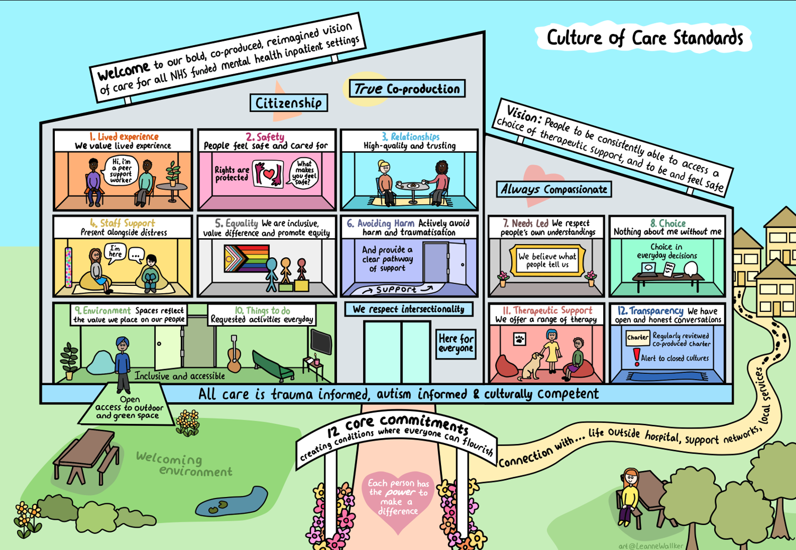



How to apply for your
Doing it Differently Bursary
Webinar
Notes:
wm

Slide 2











Plan for the session
Welcome & facilitator introductions
Application process-including examples
Q & A
Thank you
Recording part 1
Transcript Q & A
£1000
Notes:
wm

Slide 3

Aim of the fund:
• To support culture change and enable things to be done differently
Funding amount: up to £1000 per participant. Applicants can submit multiple applications but cannot claim more than £1000 in total
Criteria:
Your idea:
Fits within the Culture of Care Standards
Is co-produced with patients, carers and staff
Developed with a view of longer-term impact and culture change
Has considered any risks
£1000
Notes:
wm

Slide 4

Guidance:
The application if made up of 6 sections, it’s an opportunity for you to share with us the process and story behind your idea
Section 1: Your idea Section 4: Culture of Care Standards
Section 2: Co-production Section 5: Risks
Section 3: Impact Section 6: Funding
We need a brief overview in each section. We suggest you read over all sections before completing the form. Bullet points are accepted
If you find you have answered a question in another section, it is ok to tell is this rather than repeat information you have already told us
If a question is not relevant to your idea, please put in ‘not applicable’ and tell us why, if it is not obvious
Notes:
wm

Slide 5

Section 1: Your idea
Doing it Differently Bursary
£1000
Notes:
wm

Slide 6
Question | Guidance
1. What is name/title of your ideas | Brief and to the point
2. What would you like to do? | Remember we only need a brief overview but would love to know what your vision is
Example Answer
Garden redesign
We are hoping to provide a number of outdoor activities, some of which will be seasonal to provide a more therapeutic environment. Basic equipment that would be benefitted on the ward is: table tennis table, pedal bike, gardening supplies, yoga bat and a Bluetooth speaker.
Notes:
WM questions
GC Example

Slide 7
Question | Guidance
3. Why is this needed? | Think about what led you here. Why this idea?
Example Answer
The ward has 2 gardens, one is open access that has only 2 fixed benches in but this means it can be left open. The other is an activities garden which has more planting in. We are sensory led and have an indoor sensory space. We would like to make this garden more sensory by growing a range of herbs and safe to eat plants. The garden space is limited on the ward; one has 2 fixed benches on the grass and the other is very small with limited open space. The garden needs to be supervised at all times due to ligature risks. Having access to gardening supplies would improve not only the look of the garden, making this more inviting, but would also provide de-escalation / distraction in completing meaningful tasks, such as watering or potting plants. Having access to simple but meaningful activities provides a safe and therapeutic space for patients newly admitted to the ward. It provides opportunity for conversations to be initiated in a less formal space. Speaking with recent patients they have highlighted the importance of having a space they feel safe and comfortable to engage in conversation with staff, that does not feel clinical and they can focus their mind on an activity at the same time.
Notes:
WM questions
GC Example

Slide 8
Question | Guidance
4. Who will benefit from it and who will be involved? | A list of beneficiaries and who is involved
Example Answer
The patients will be the main benefiter from the improvements to the ward. They have all often spoke about wanting to make improvements to the garden space to make this more inviting, giving them the opportunity with fill them with a sense of purpose and achievement. Staff will also be able to benefit from the improvements as they will have readily access to provide meaningful activities and promote a therapeutic relationship with patients. It will also provide staff to carry out their clinical work whilst engaging patients in activities, they may not engage otherwise – helping to create a better sense of their mental state. Unfortunately due to the nature of the ward environment carers are unable to access the garden so will not directly benefit from the improvements. However, hearing about the activities their family have been involved in will aim to improve their experience with the service as we are demonstrating a variety of activities – something which family have fed back is limited on the ward.
Notes:
WM questions
GC Example

Slide 9
Question | Guidance
5. How long do you expect it to run it for? Do you have a start and end date in mind? | Answering this will depend on your idea. You may be exploring options or have already made a more definite plan. If it is not applicable just add N/A. This will also give us an idea of when to send your monitoring form. A rough guide is acceptable.
Example Answer
This will be an ongoing project that can be developed over time and adapted to meet the current needs of the service users on the ward. We are hoping to get the project started as soon as possible. At present there are off site groups that run, involving an allotment group however our patient population often means they do not have access to leave and is something that takes time to work towards. Having something positive and meaningful to offer them in the time of waiting will help to improve the relationship between staff and service users.
Notes:
WM questions
GC Example

Slide 10
Question | Guidance
6. Is it something new, or are you continuing something that has worked well previously? | Tell us if this is a brand-new idea or building on or enhancing some other work you are already doing
Example Answer
This is a new idea to redesign the garden, taking into consideration sensory needs, safe wards and aspects of trauma informed care. This provides a less clinical environment which patients have fed back makes them feel calmer and safer to open up and engage with staff. Additionally, having access to sports equipment on the ward will be beneficial for those with no access to leave from the Hospital. It also means it is something that can be offered outside of normal working hours, so after 5pm, weekends or bank holidays as the nursing team will have access to equipment to provide meaningfully activities. We have found as a ward specifically, most of our incidents happen out of hours due to levels of boredom, having access to this equipment will greatly reduce this. Previously, we have used old sports equipment to engage service users and held small table tennis competitions. This was greatly beneficial at improving the relationship between staff and services users, as well as the services users’ collectively.
Notes:
WM questions
GC Example

Slide 11

Section 2: Coproduction
Doing it Differently Bursary
£1000
Notes:
GC

Slide 12
Question | Guidance
1. How have you worked with patients, carers and the wider staff team to develop your idea? | Please share what you did to include a variety of voices for example: Did you hold a ward meeting with colleagues, patients, carers? Have you used a survey or held a focus group? Did the idea originate from a patient, carer or member of your team?
Answer
We hold weekly meetings with the patients, often a lot of feedback received is wanting to improve the garden facilities which lead us to the idea of providing specific equipment. We also spoke with all staff during team meetings and sent out mass emails to collect feedback on what ideas would be beneficial. Most ideas were focused around sports equipment and sensory items, as this provides purpose for conversations and also staff to be creative when designing activity timetables, especially out of hours.
Notes:
GC questions
WM Example

Slide 13
Question | Guidance
2. How will you ensure people are involved throughout the development and implementation of your idea? | Examples might include: Setting up a regular meeting for everyone involved to be part of the process Sending update emails and texts Postcards Assigning and sharing out roles in the development of your idea e.g. a patient may take the lead on sharing news with other patients
Answer
We will continue to hold weekly meetings with the service users to obtain their feedback on how they believe the equipment is benefiting them. This will also provide opportunity to make any changes to equipment or accessibility, for example wanting more flowers or herbs etc. This will also be addressed in monthly team meetings to highlight what areas are working well, areas for improvement or changes that need to be made. This may happen more frequently but will be largely dependant on the service user group at the time.
Notes:
GC questions
WM Example

Slide 14
Section 3: Impact
Doing it Differently Bursary
£1000
Notes:
GC

Slide 15
Question | Guidance
1. What impact do you and others hope your idea will have? | This section is about sharing with us the impact you hope your idea may have. We need to see that you have considered the possibilities
Answer
The nursing team are hoping this has a positive impact on the experience service users have being on the ward. They hope by being able to provide them with meaningful activities will provide them with a sense of purpose / achievement, and in turn lead to better working relationships with service users. The nursing team are also hopeful that having access to better equipment and provision will enable them to create and offer more activities on the ward that the service users would otherwise not have access to. They are hoping to create a therapeutic space that is outside of the clinical environment of the ward, whilst still maintaining safety. Additionally, knowing what equipment is available will allow the team to create timetables of activities. This will be largely out of hours as this is known to be when most incidents occur on the ward. The team hope having meaningful activities to offer, that service users have requested will improve their engagement and reduce levels of boredom and distress.
Notes:
GC questions
WM Example

Slide 16
Question | Guidance
2. How will you know it has made a difference? | Think about what you, patients, carers and other staff might see, hear or feel as your idea becomes a reality
Answer
Our patients will ideally be able to inform staff of the positive impact this has had on them, as well as any areas for improvement / development. This would ideally happen when their mental state has improved slightly and they are able to engage in deeper conversations. We also hope that there would be a reduction in incidents, especially those out of hours with the availability of activities. We know this may not always be the case as wards will never be incident free, but a reduction in frequency would highlight that the equipment has been beneficial.
Notes:
GC questions
WM Example

Slide 17
Question | Guidance
3. How will you capture evidence to: Evaluate success? Measure impact? Use learning to shape future ideas and actions? | Examples might include: Asking people to feedback on a sticky-note Taking photographs and quotes from people Interviews with patients, carers and staff
Answer
We will provide service users with a feedback form specifically related to the activities we have offered with the equipment provided. This will highlight the areas they have enjoyed, what they found beneficial and any changes they would suggest making. The team would also take regular photographs and provide updates to the wider trust through our space, highlighting the good work done and the impact this was having on the ward environment generally. During carers meetings / calls we would also ask for their feedback on how they feel the improvement to activities has benefitted their experience and the carer received for their loved one. This will also provide space to highlight any ideas they have or changes they think would be beneficial to ensure all parties are working closely together to positively impact the ward environment,
Notes:
GC questions
WM Example

Slide 18
Question | Guidance
4. How might you ensure your idea is sustainable? | Examples might include: O By gathering evidence of success, we hope to build a business case to present to senior managers to continue to grow the idea O We are introducing an enterprise aspect to our nature club by having a healthy tuck shop where patients, staff and visitors can purchase things to help sustain a small fund
Answer
Once the initial funding has been provided, we can look to make a business case using evidence from feedback to maintain supplies. Also a number of staff are gardeners themselves and can supply excess plants as we have previously. The majority of this will only require small funds to maintain the benefits
Notes:
GC questions
WM Example

Slide 19
Section 4: Culture of Care Standards
Doing it Differently Bursary
£1000
Notes:
WM Both

Slide 20
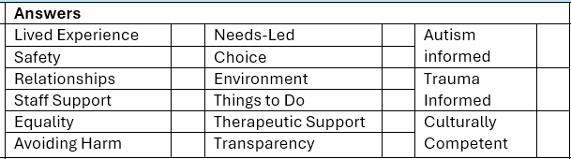
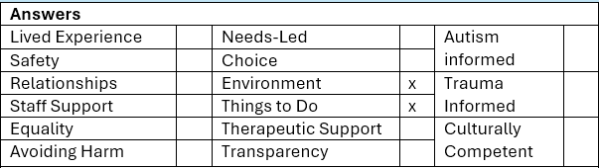
Question | Guidance
Which Culture of Care Standard or standards and equity principles will your idea contribute to? | Please put a cross or shade out the main ones that are relevant
Notes:
WM Both

Slide 21
Question | Guidance
Please explain how your ideas are contributing to each of the standards or equity principles that you have chosen | We just need a brief overview for example O Lived Experience: Setting up a monthly co-production group on the ward is helping to ensure patients are supported to have their voice heard and help with on-going co-production on the ward. Our organisation’s strategic peer lead is facilitating the space and ensures issues and ideas from our ward feed into the senior management group
Answer
Environment: Making the gardens more of an inviting but also active space for activities, extends the ward environment and promotes care in nature which our trust is leading with currently. It would allow people sensory input from colours, smells etc within a safe environment. It also gives people the option of using this space with therapists. Things to do: The current patient population will be involved in the development of the garden and therefore is a task for them. Equally the activities we can purchase ensure that a range of options can be used out of office hours.
Notes:
WM Both

Slide 22
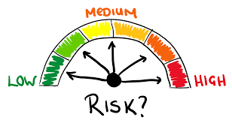
Section 5: Risks
Doing it Differently Bursary
£1000
Notes:
GC Both

Slide 23
Question | Guidance
What are the risks associated with your idea? | Please tell us any of the risks relating to your idea. For example: Risk: Reluctance of wider team to get involved because of time pressures Mitigation: Involving wider team from the start and working with them to understand and include their perspective to encourage engagement and motivation Consider individual and organisational risks
What steps have you considered to mitigate the risks?
Answer
Risk: Misuse of equipment provided. Mitigation: Depending on how many service users wish to participate in the activity will depend on how many staff are allocated to support them. We would hope for at least 2 /3 members of staff to support the service user if this is a group activity or 1:1 would also be appropriate. The staff would only take out the required equipment for the activity they were doing and ensure the service users were supervised at all times. Risk: Harm to self or others. Mitigation: Risk assessments would be carried out prior to offering activities on the ward. If the risk was deemed to high, either to self or others adaptations could be made whilst still ensuring the service user is able to participate. For example, they may not be given access to planting tools but could still use the seeds / flowers.
Notes:
GC Both

Slide 24
Question | Guidance
How have you considered all the relevant organisational policies and procedures that might be relevant to your idea? | Examples of this may include: O Ensuring any equipment purchased meets health and safety regulations O Buying in services from reputable providers who have relevant insurance and DBS certificates for staff
Answer
Any equipment provided would be checked and monitored by the health and safety lead for the ward. This will ensure it is in safe and effective use to prevent the risk of injury or damage.
Notes:
GC Both

Slide 25
Section 6: Funding
Doing it Differently Bursary
£1000
Notes:
DW

Slide 26
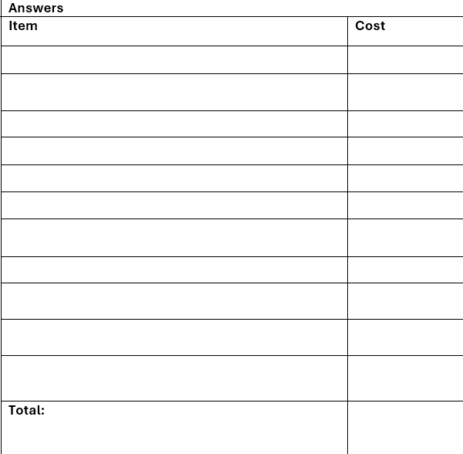
Question | Guidance | Full breakdown
What are the costs associated with your idea? | Please list each item separately. Ensure costs are accurate and based on quotations. Examples of what we may fund Equipment, materials Coaching and activity costs One-off events Lived experience involvement fees Training costs Volunteer expenses Transport to support engagement Refreshments/room hire if no other option and will prevent idea developing We cannot fund Retrospective costs Alcohol Statutory activities Things normally funded by your organisation Overseas travel Cash that will be given directly to individuals Political activity and campaigning
Notes:
DW

Slide 27
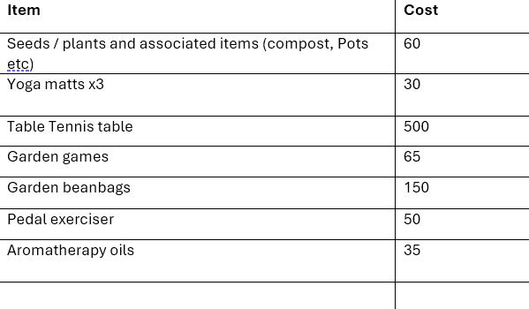

Answer
Total
£890
Notes:
DW

Slide 28
Question | Guidance
Is this the total cost of your idea or part of a larger project for which you are receiving other financial contributions? | An example of this might be that the ward is renovating a whole outdoor space with organisation funding and this application for funding is supporting the development of a sensory garden
Answer
Total cost bar upkeep which can sit within ward budget
Notes:
DW

Slide 29
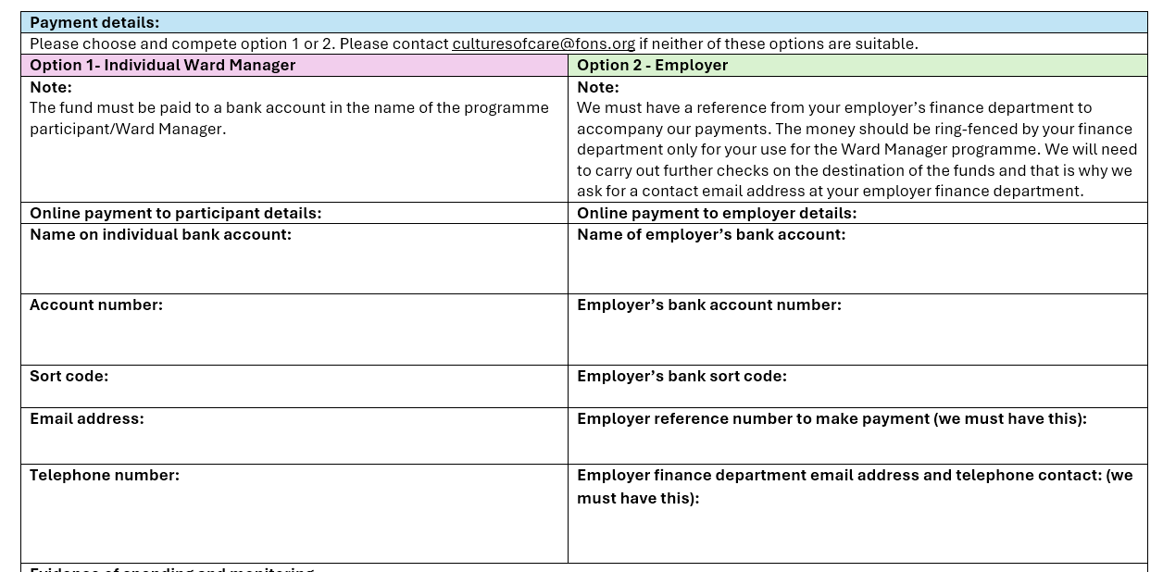
Notes:
DW

Slide 30
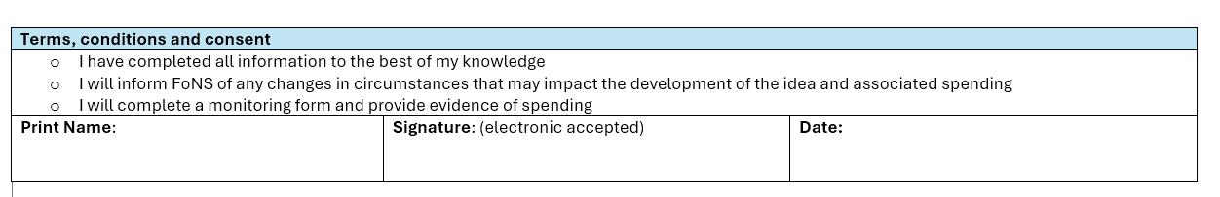


culturesofcare@fons.org
Notes:
DW

Slide 31
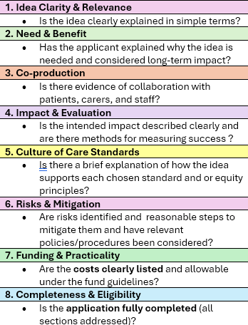
Approval process:
Applications are considered by a bursary committee made up of FoNS staff including those with lived experience
Decisions are based on each section of the application
Reviewed at least fortnightly. We aim to get back to you within 2 weeks
Applications are Applications can be made throughout your ward managers programme and up to 3 months after completion.
We are happy to discuss any special circumstances if an extension is required.
Support:
Reach out and ask us for support-there is no such thing as a silly question
Notes:
DW

Slide 32
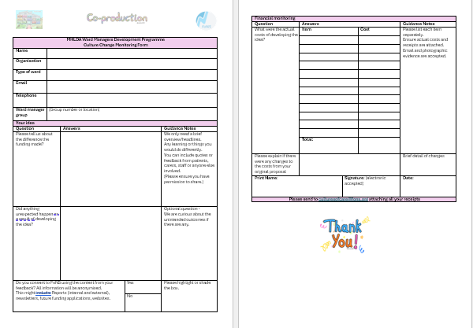

Monitoring
Evidence of spending and monitoring
We will send out a monitoring form to capture evidence of spending and key learning from your work.
Ensure you keep receipts (email confirmation and photos of receipts are acceptable) as we will need copies of these.
Please tell us about the difference the funding made?
Did anything unexpected happen as a result of developing the idea?
Do you consent to FoNS using the content from your feedback? All information will be anonymised.
Actual spending breakdown
Notes:
DW

Slide 33



Notes:
DW

Slide 34

culturesofcare@fons.org

